Slide 1
MBA Lecture Note
Introduction to Big Data and Artificial Intelligence
Lecturer: Jinkyu Kim
Hanyang University, Ph.D. student
CONFIDENTIAL DO NOT USE FOR OTHER PURPOSES

Slide 2
Contents
Ⅰ. Big Data Revolution: Trend
Ⅱ. Terminology Description
Ⅲ. Alternative Datasets
Ⅳ. Machine Learning Techniques
Ⅴ. Supervised Learning
VI. Unsupervised Learning
VII. Deep Learning
VIII. Application
00. Epilogue

Slide 3
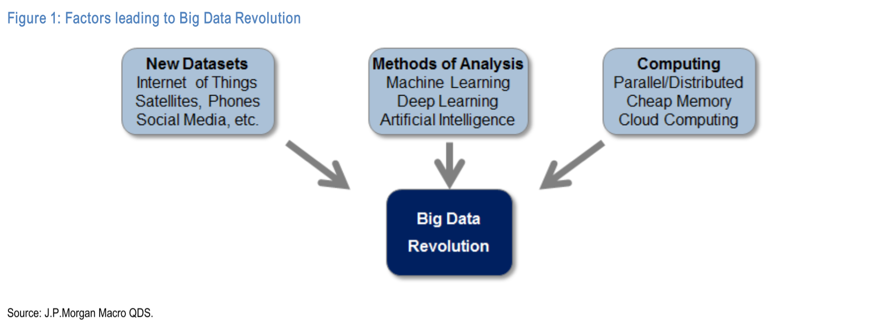
1. Big Data Revolution: Trend
□ Exponential increase in amount of data available
□ Increase in computing power and data storage capacity, at reduced cost
□ Advancement in Machine Learning methods to analyze complex datasets

Slide 4
1. Big Data Revolution: Trend
□ Amount of data
- 90% of the data in the world today: created in the past two years
- Expected: 4.4 zettabytes (2015) => 44 zettabytes (2020) cf) 1 zettabyte = 1,000,000,000,000 Gb
- Further Acceleration: IoT (Internet of Things), smart phones, cost reduction in satellite techs

Slide 5
1. Big Data Revolution: Trend
□ Computing power & Storage “Cloud Computing” – Physical Ability
- Remote, shared access to resources
ex) A single web search on Google: coordinated across ~1000 computers
ex) Software-as-a-service (SaaS), Platform-as-a-service (PaaS), etc.
- Diminished the barriers to large-scale data processing and analytics

Slide 6
1. Big Data Revolution: Trend
□ Machine Learning methods – Software Ability
- Part of Statistics and Computer Science
- Enable analysis of large and unstructured datasets
- Classical Machine Learning, Deep Learning, Reinforcement Learning
- Ex) Amazon Echo, Google Home, Apple Siri, …
“Just 0.5% of the data produced is currently being analyzed [Regalado (2013)]”
- Compelling reason for learning about new datasets and ML toolkits.

Slide 7
2. Terminology Description
□ “Big” Data
□ Machine Learning
□ Artificial Intelligence

Slide 8
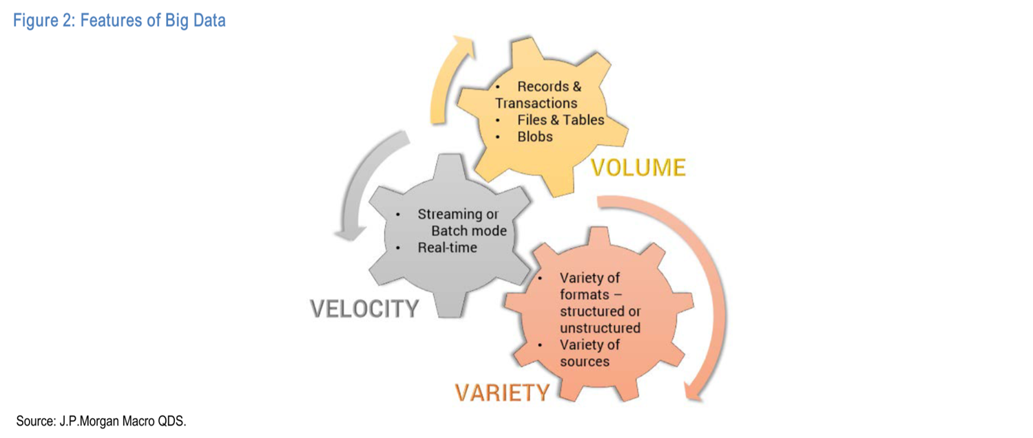
2. Terminology Description
□ “Big” Data: What is Big?
- Volume: the size of data is huge
- Velocity: the speed with which data is sent or received
- Variety: variety of formats (structured, semi-structured, unstructured)

Slide 9
2. Terminology Description
□ Machine Learning (ML)
- Goal: enable computers to learn from their experience in certain tasks
- Enable the machine to improve performance as their experience grows
- Category: Supervised Learning, Unsupervised Learning, Deep and Reinforcement Learning

Slide 10
2. Terminology Description
□ Artificial Intelligence (AI)
- Broader scheme of enabling machines with human-like intelligence
- At the first stage: hardcoding a large number of rules “Symbolic-AI”
- Machine Learning is another attempt to achieve AI
- Machine Learning & Deep Learning so far represent the most serious attempt at achieving AI (image&pattern recognition, language trans., etc.)

Slide 11
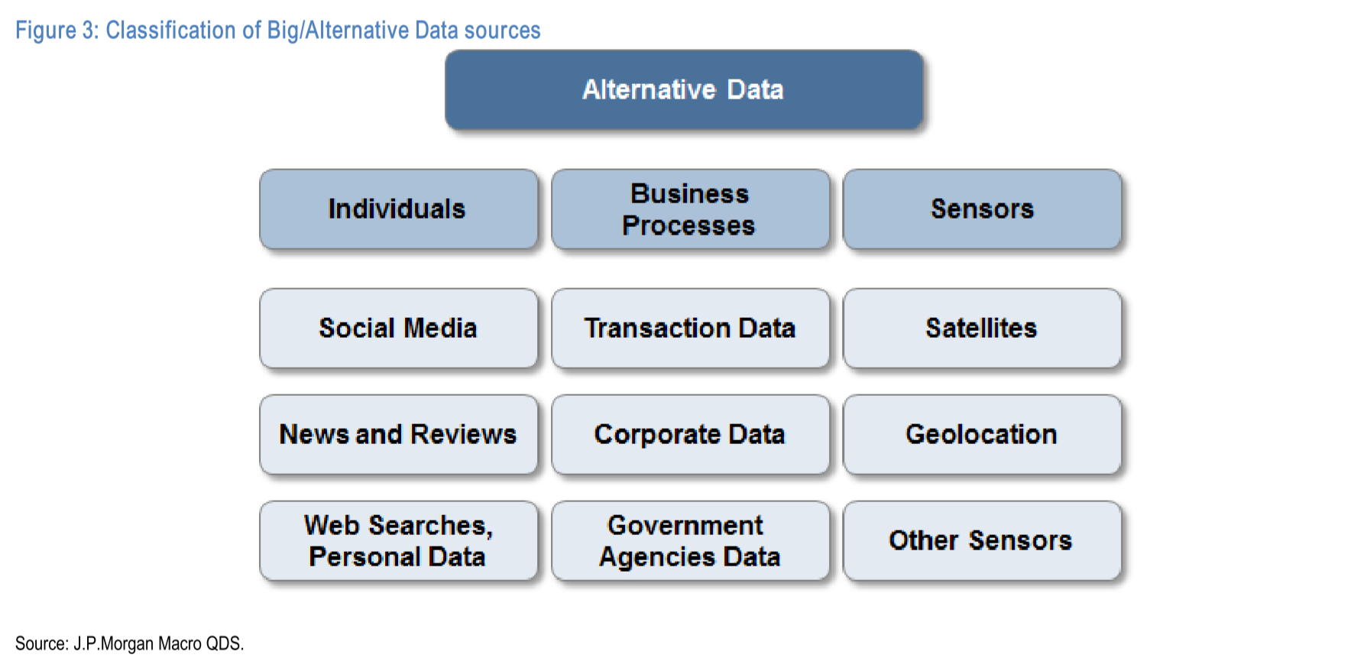
3. Classification of Alternative Data Sets
□ Data generated by individuals
□ Data generated by Business Processes
□ Data generated by sensors

Slide 12
3. Classification of Alternative Data Sets
□ Data generated by individuals
- Mostly recorded through textual mediums (unstructured & distributed across multiple platforms)
□ Possible sources
- Social media: Twitter, Facebook, LinkedIn, etc.
- Specialized sites: Business-reviewing website Yelp, E-commerce groups like Amazon, Mobile App analytics companies like App annie
- Web searches, and personalized data such as Google Search trends, etc.

Slide 13
3. Classification of Alternative Data Sets
□ Data generated by Business Processes
- produced by corporations and public entities (often highly structured)
□ Examples - transaction records such as credit card data
- banking records - supermarket scanner data
- supply chain data

Slide 14
3. Classification of Alternative Data Sets
□ Data generated by sensors
- mechanically collected data through sensors embedded in various devices (typically unstructured & size is massive)
□ Examples - satellite imaging - geolocation data
- cameras fixed at a location (ex. CCTV)
- weather and pollution data
- IoT (Internet of Things)

Slide 15
4. Classification of Machine Learning Techniques
□ Necessity of New Methods
- Large and less structured data: hard to handle with spreadsheet program
- New methods of automatically analyzing unstructured data are needed
- ML yielded some spectacular results (image & pattern recognition, natural language processing, auto-driving)
“What is the application of ML in finance,
and how do these methods differ from each other?”

Slide 16
4. Classification of Machine Learning Techniques
□ First stage: Symbolic Artificial Intelligence – not a ML
- We can instruct a computer to perform certain tasks based on rules.
- Why don’t we give machines a large number of rules so that it appears to be “intelligent”? (This is a so-called “Symbolic AI”)
- However, it will freeze the first time it encounters a situation that does not exactly match a set of pre-programmed rules.
- This is not a Machine Learning. It’s just making a lot of rules.
=> Not a big success

Slide 17
4. Classification of Machine Learning Techniques
□ Machine Learning
- the computer is given an input (set of variables and datasets) and output (consequences of input variables)
- The machine then finds or “learn” a rule that link input and output
- ML has 3 important sub-categories, i.e., supervised learning, unsupervised learning, deep learning

Slide 18
4. Classification of Machine Learning Techniques
□ Supervised Learning
- answer sheet
- trying to find a rule, an “equation” that we can use to predict a variable.
□ Unsupervised Learning
- no answer sheet
- uncovering the structure of data
□ Deep Learning
- similar to how people learn
- ex) A child will learn concept of face by identifying some simple features like eyes, nose, mouth, etc. From simple features one builds a more complex concepts such as face.

Slide 19
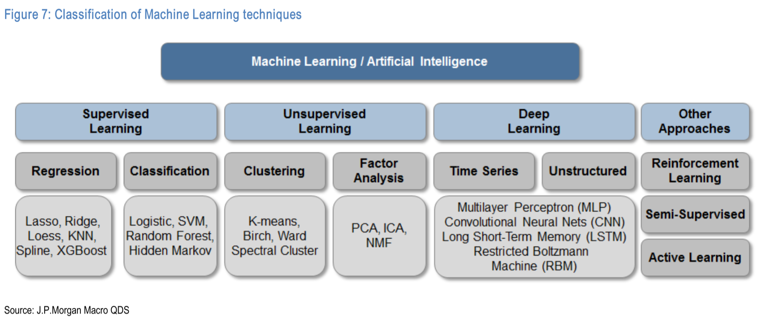
4. Classification of Machine Learning Techniques
□ Classification of ML techniques

Slide 20
5. Supervised Learning
□ Supervised Learning
- Algorithm is provided with historical data (both input and output variables) and is trying to find the relationship that has the best predictive power for out of the sample data
□ Regression and Classification
- Regressions: try to predict output variables based on a number of input variables (ex. predict asset returns)
- Classification: attempt to group or classify output into categories (ex. decide buy/sell actions)

Slide 21
5. Supervised Learning-Regression
□ Linear Regression
- Even a simple linear regression can be thought of as a Supervised Machine Learning method.
- Sometimes, it is too simplistic to uncover the true relationship.

Slide 22
5. Supervised Learning-Regression
□ Penalized Regression
- the optimizer will set unnecessary and very large betas to zero

Slide 23
5. Supervised Learning-Regression
□ K-Nearest Neighbor (KNN)
- Given a new datapoint, we search through historical data and identify a number of K of similar instances
- Once we have located K nearest neighbors, we can average the output variable y for this subset and use that as our prediction
□ LOESS
- Using data for K-nearest neighbors, for each new point we fit a linear regression based on the K nearest neighbors, and predict the output using those coefficients
=> Simple way to extrapolate analysis on past similar events

Slide 24
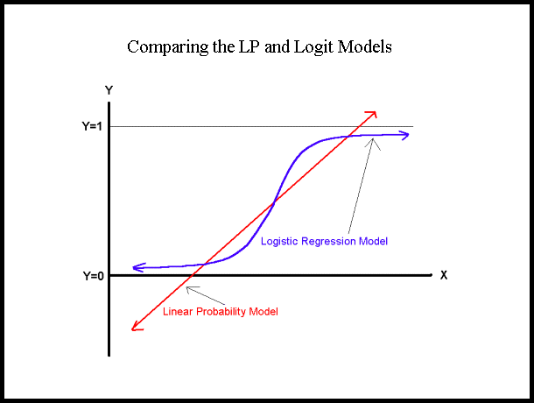
5. Supervised Learning-Classification
□ Logistic Regression
- produces output as a binary decision such as “buy” or “sell”
- forecast the probability of an event given historical sample data

Slide 25
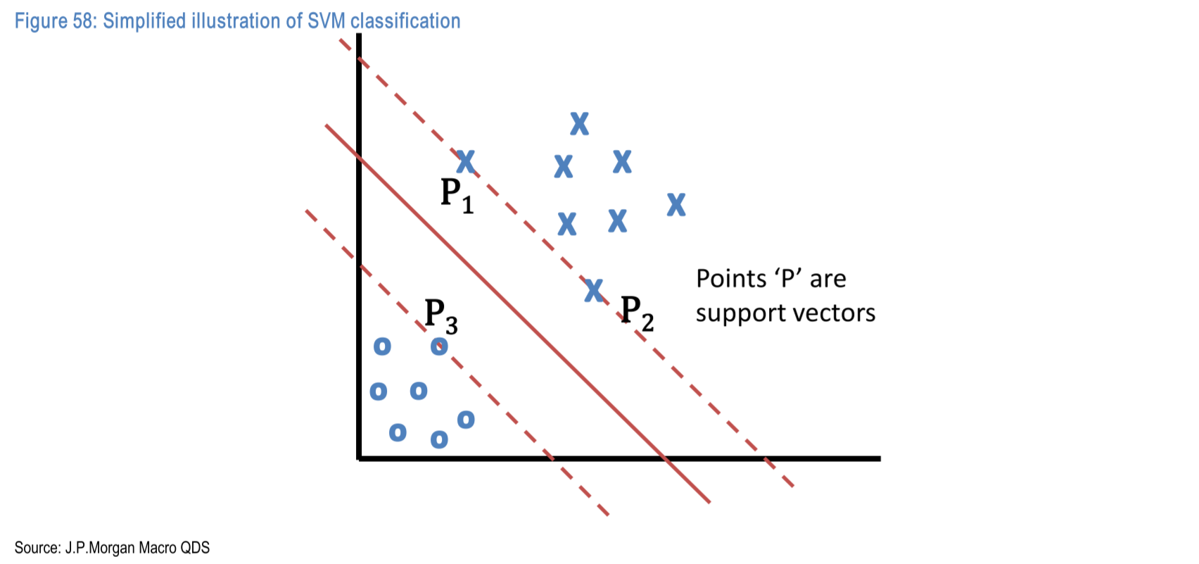
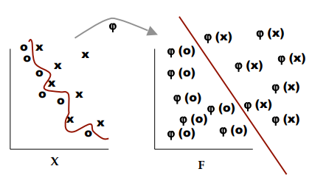
5. Supervised Learning-Classification
□ Support Vector Machine (SVM)
- the most popular classification algorithm
- enhance with new derived features / axis-transform / higher dimension

Slide 26
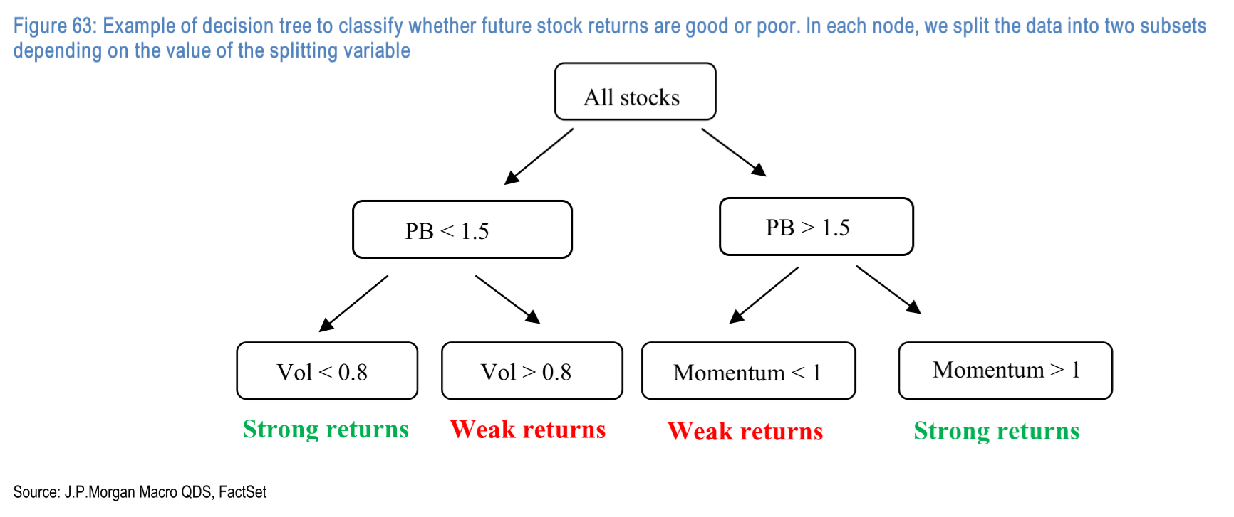
5. Supervised Learning-Classification
□ Decision Tree
- Essentially, flow charts used commonly in business management
- To fit a decision tree, the algorithm usually looks for the best variable and the best splitting value among all possibilities, so that a particular loss function is minimized

Slide 27
5. Supervised Learning-Classification
□ Random Forests
- A single decision tree is capture the structure of the in-sample data very well, but it tends to work poorly out-of-sample (overfitting)
- Bagging: draw many random subsets of the original data
- Fit a decision tree on each subset
- Average the predictions of all decision trees
=> Reducing the variances of the prediction

Slide 28
6. Unsupervised Learning
□ Unsupervised Learning
- Identify relationships between variables and their common drivers
- In unsupervised learning, the machine is simply given the entire data sets and it does not have a notion of what are independent and what are the dependent variables
□ Clustering and Factor analysis
- Clustering: splitting a dataset into smaller groups based on similarity
- Factor Analysis: identify the main drivers of the data

Slide 29
6. Unsupervised Learning-Clustering
□ Clustering
- In the supervised learning, the algorithm tries to minimize the sum of squared errors, i.e., (predicted value – actual value)^2.
- Now, we have no answer sheet. We don’t know what actual values are.
- In this situation, how can we compute errors?

Slide 30
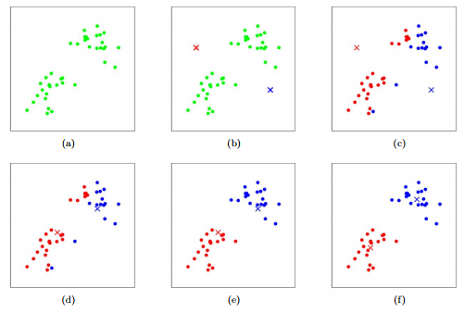
6. Unsupervised Learning-Clustering
□ K-means clustering
- simplest clustering algorithm
- algorithm starts by initially marking random points as centroids
- it iteratively does a two-step calculations
1. maps points to closest centroids
2. redefines the centroid as the mean of the points mapped to it

Slide 31
6. Unsupervised Learning-Clustering

Slide 32
6. Unsupervised Learning-Factor Analysis
□ Factor Analysis
- Goal: identify the main drivers of the data or identify the best representation of data
□ Principal Component Analysis
- a very well-known method of factor analysis
- originally a statistical tool for dimensionality reduction

Slide 33
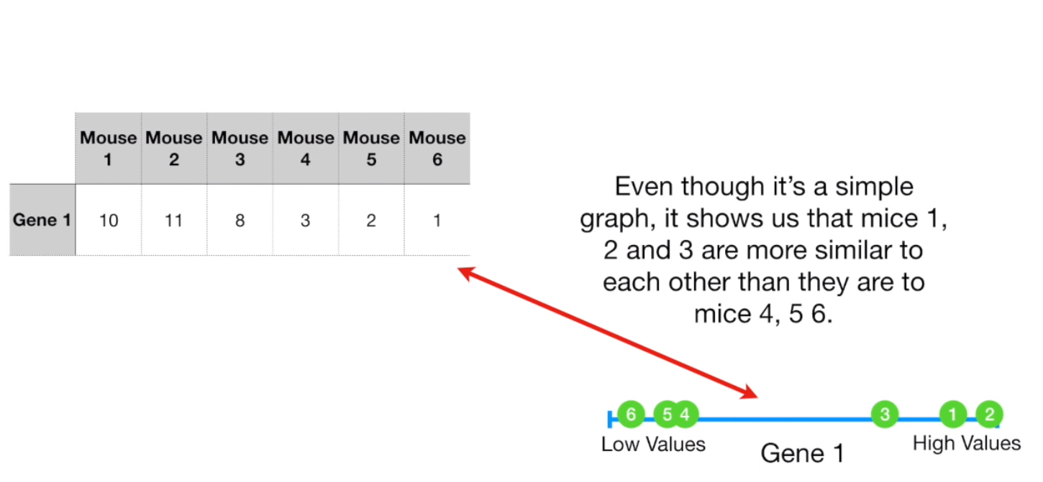
6. Unsupervised Learning-Factor Analysis
□ Principal Component Analysis - Intuition
- Assume we want to categorize observations based on similarities
- If we have only one characteristic, that characteristic is the only reference so that we can compare each group based on that reference

Slide 34
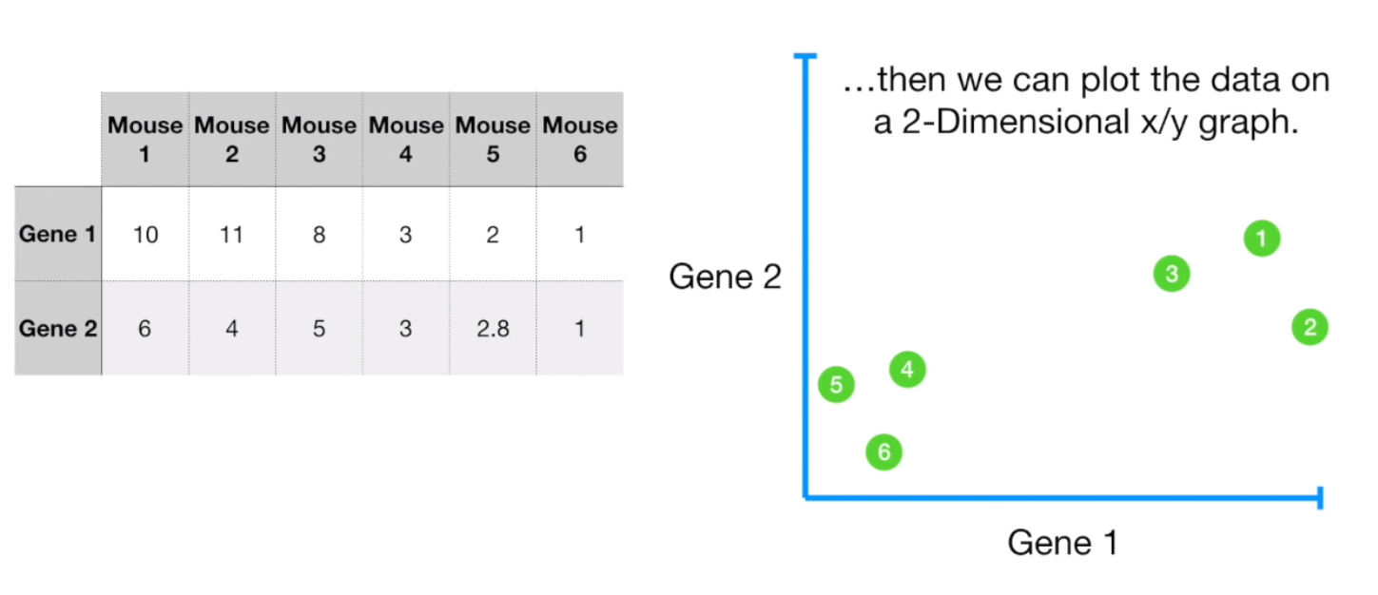
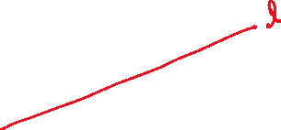
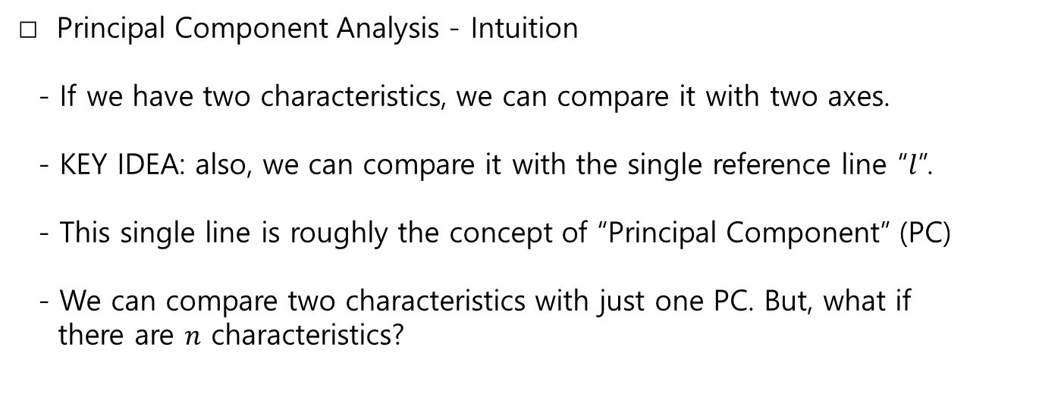
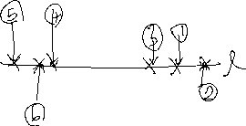
6. Unsupervised Learning-Factor Analysis
□ Principal Component Analysis - Intuition
- If we have two characteristics, we can compare it with two axes.
- KEY IDEA: also, we can compare it with the single reference line “$l$”.
- This single line is roughly the concept of “Principal Component” (PC) - We can compare two characteristics with just one PC. But, what if there are $n$ characteristics?

Slide 35
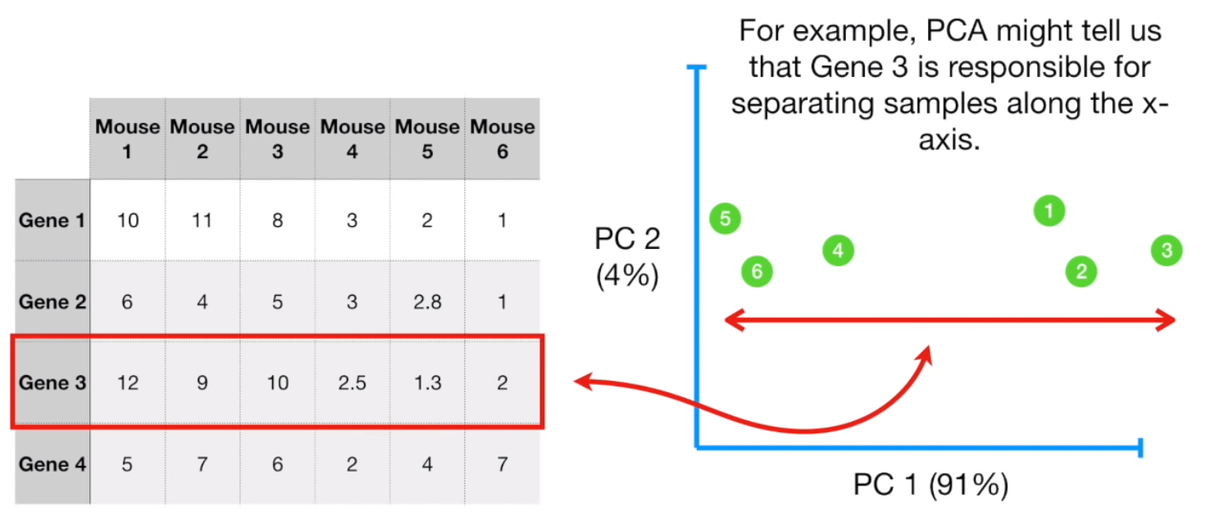
6. Unsupervised Learning-Factor Analysis
□ Principal Component Analysis - Intuition
- PCA is the technique that extract the most valuable characteristics or the combination of characteristics for clustering the data. (high variation)
- That is, PC can be thought of as the most important part of the variation that explains the variation of characteristics of entire samples
- Once we finish the extraction of PC, we can compare observations based on the extracted PC.
- For example, PCA might tell us that Gene3 is responsible for separating samples along the x-axis.

Slide 36
7. Deep Learning
□ Deep Learning
- analyzes data in multiple layers of learning
- simpler concepts => combining => complex and abstract
□ Deep Learning vs. Classical Machine Learning
- Classical machine learning perform well on numerical prediction and analysis tasks
- But not at “intuitive” things (ex. recognizing images, analyzing texts)
- Goal of Deep Learning: perform tasks that are difficult for people to define, but easy to perform

Slide 37
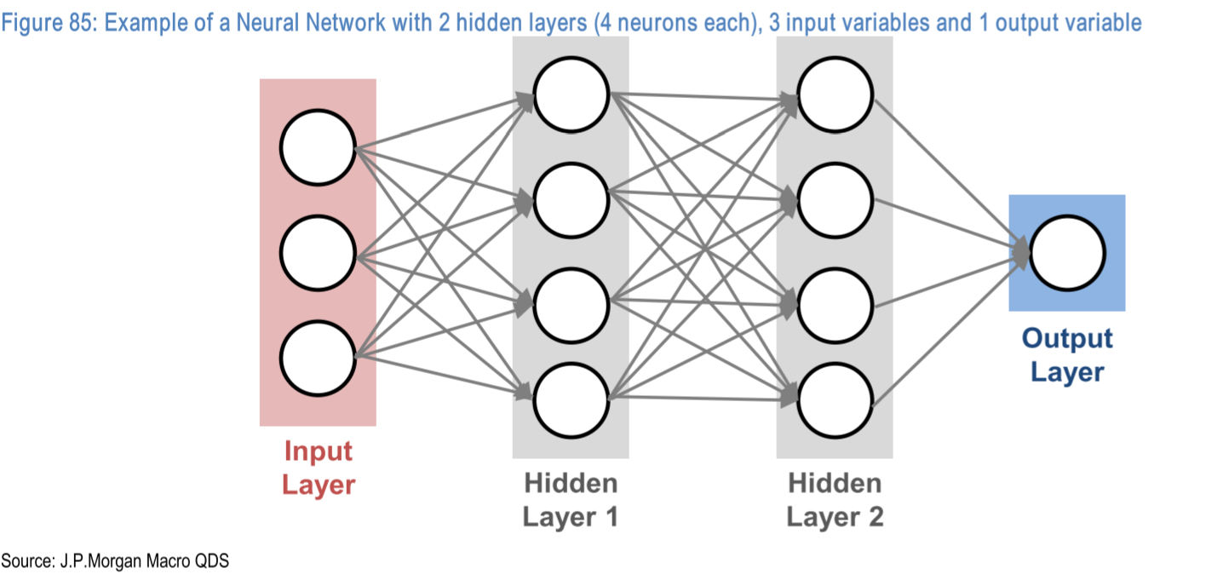
7. Deep Learning
□ How it works
- Neuron: a simple calculator that computes first the weighted average of inputs given to it and then output the result if the value exceeds a pre-determined threshold

Slide 38

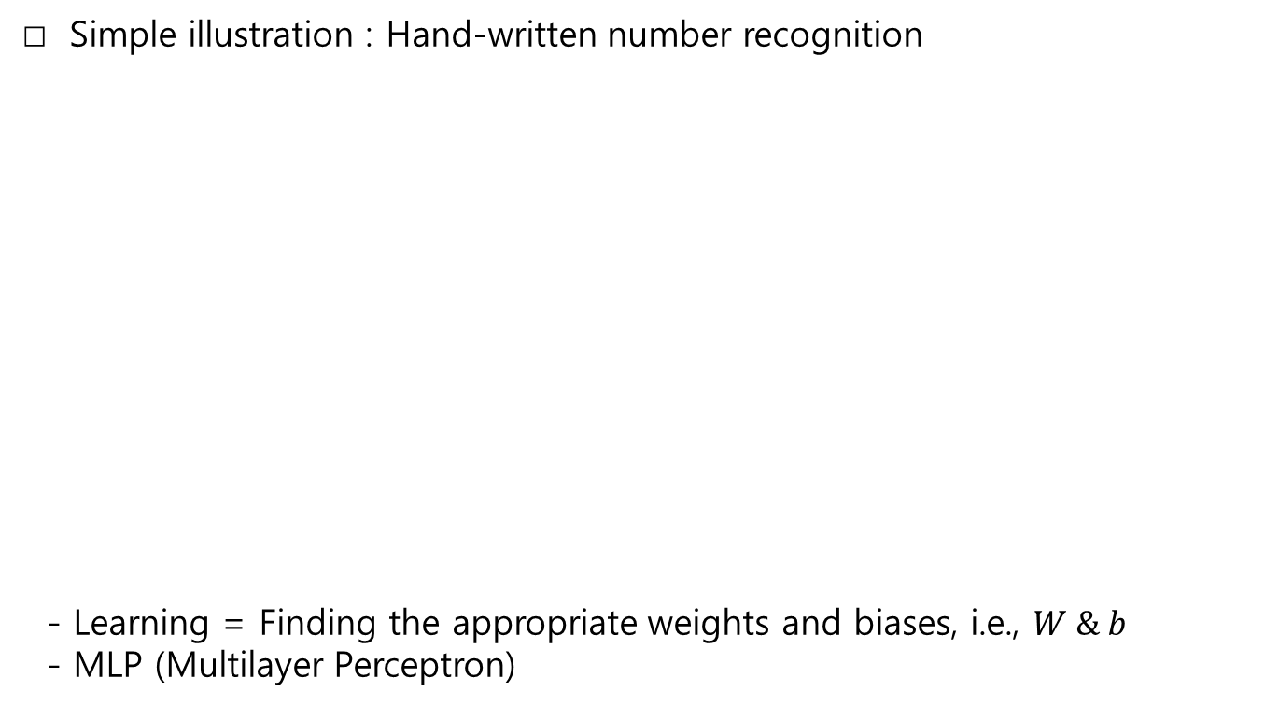





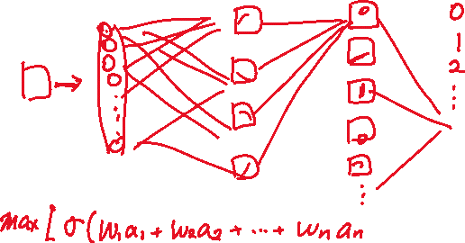
7. Deep Learning
□ Simple illustration : Hand-written number recognition
- Learning = Finding the appropriate weights and biases, i.e., $W \& b$
- MLP (Multilayer Perceptron)

Slide 39
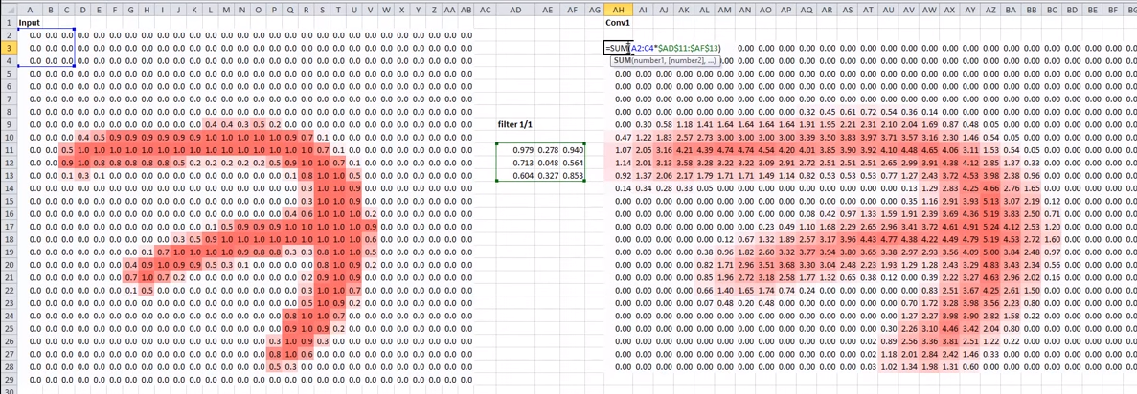
7. Deep Learning
□ CNN (Convolutional Neural Network): Extension1
- Let’s use convolutional filter as a layer to detect the edge of images well

Slide 40
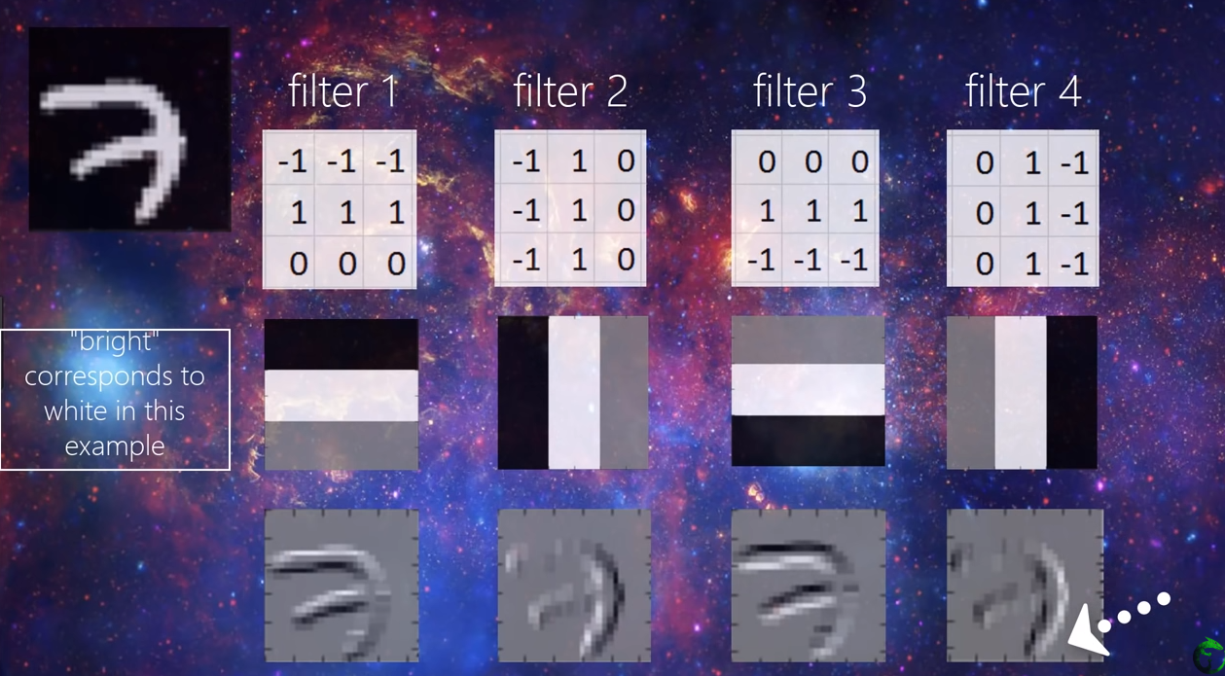
7. Deep Learning
□ CNN (Convolutional Neural Network): Extension1
- One simple convolution layer

Slide 41
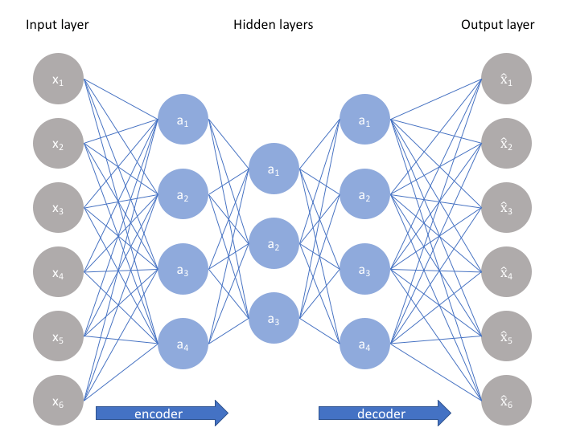
7. Deep Learning
□ Auto-encoder: Extension2
- Why not reverse-engineer the extracted feature and reconstruct the original input and compare it with the “real” original one?

Slide 42
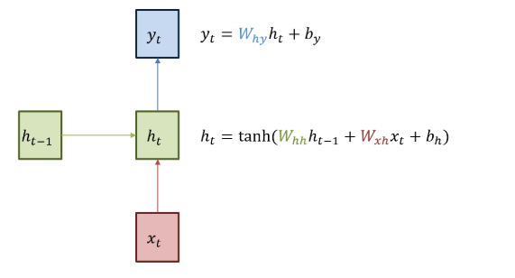
7. Deep Learning
□ RNN (Recurrent Neural Network): Extension3
- Why not incorporate historical contexts to the learning method? ex) predicting consecutive letter of word? h,e,l,l,o
- Vanishing gradient problem: cannot deal with long term memory (structure of the product, characteristics of tanh)

Slide 43
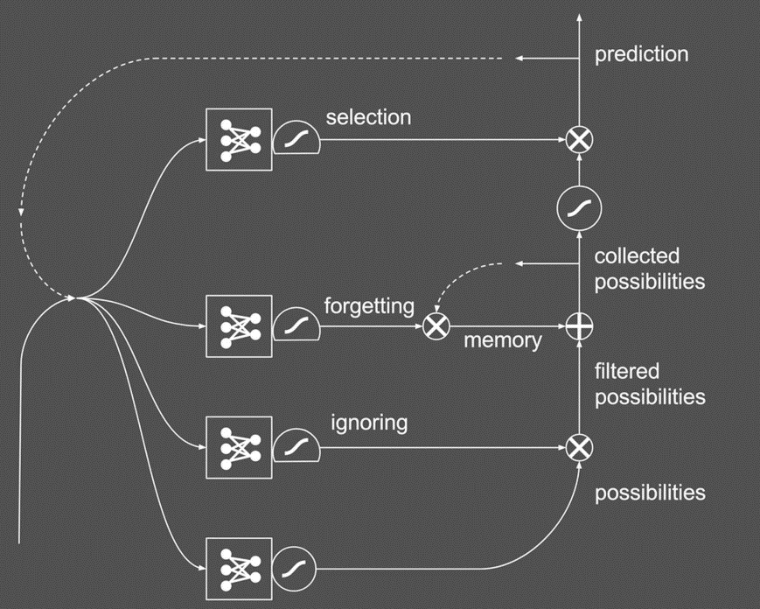


7. Deep Learning
□ LSTM (Long-Short Term Memory): Extension4
- Add special boxes to the RNN to adjust vanishing gradient problem

Slide 44





7. Deep Learning
□ LSTM Example: Let’s make a children’s book
- component: Jane, Spot, Doug, saw, .
- Goal:
Jane saw Spot.
Spot saw Doug.
Doug saw Spot. …
- Possible mistakes:
Jane saw Jane.
Doug saw Spot saw …
Doug.
- Current stage:
Jane saw Spot.
Doug …

Slide 45




7. Deep Learning
□ LSTM Example: Let’s make a children’s book
- component: Jane, Spot, Doug, saw, .
- Goal:
Jane saw Spot.
Spot saw Doug.
Doug saw Spot. …
- Possible mistakes:
Jane saw Jane.
Doug saw Spot saw …
Doug.
- Current stage:
Jane saw Spot.
Doug saw …

Slide 46

8. Application: General

Slide 47

8. Application
□ deep-photo-styletransfer: input, style, output

Slide 48
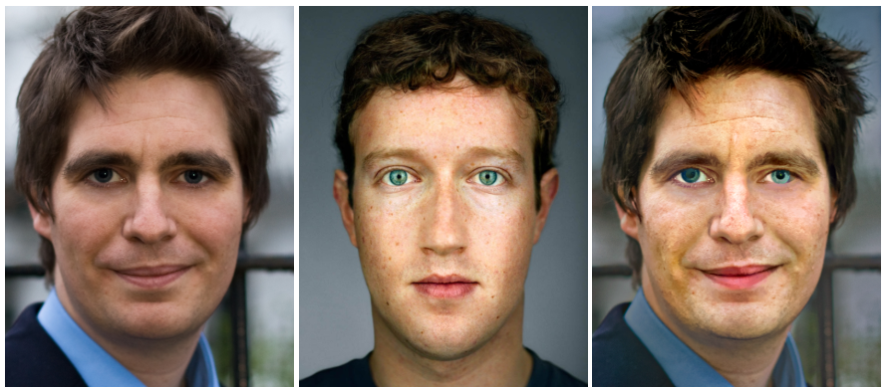
8. Application
□ deep-photo-styletransfer: input, style, output
- how to map style to the original contents?
- extension of CNN

Slide 49
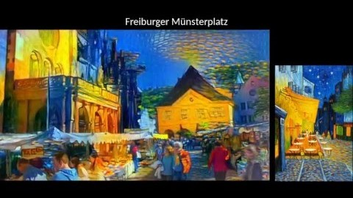
8. Application
□ deep-photo-styletransfer extension

Slide 50
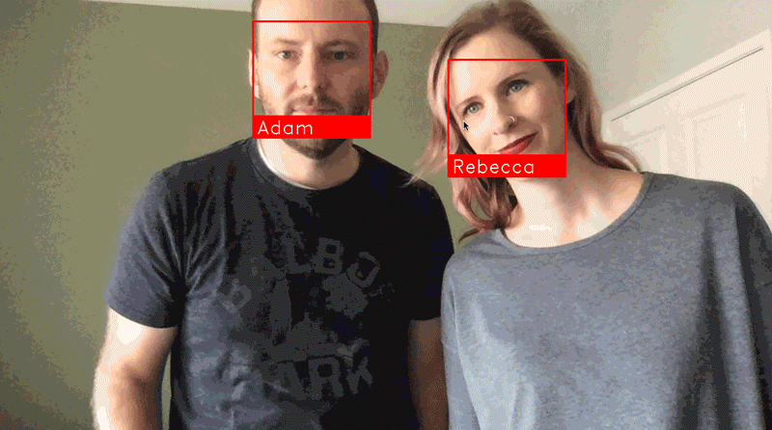
8. Application
□ Face recognition

Slide 51
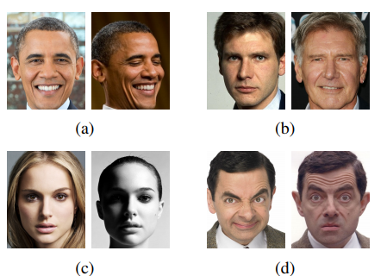
8. Application
□ Face recognition
- Overcome this!

Slide 52
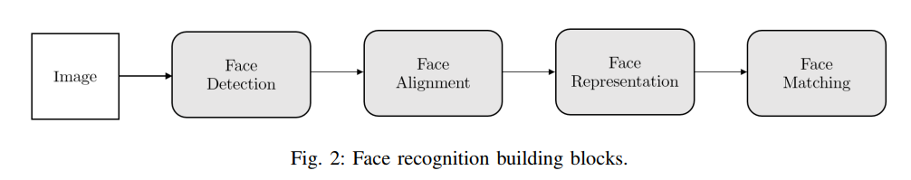
8. Application
□ Face recognition
- Face detection: find the position of the faces
- Face alignment: scale and crop face images to compare with references
- Face representation: pixel values of face images->feature vector
- Face matching: compare the similarity score
- This time again, CNN

Slide 53

8. Application
□ Magenta: Art and Music composer
- RNN

Slide 54
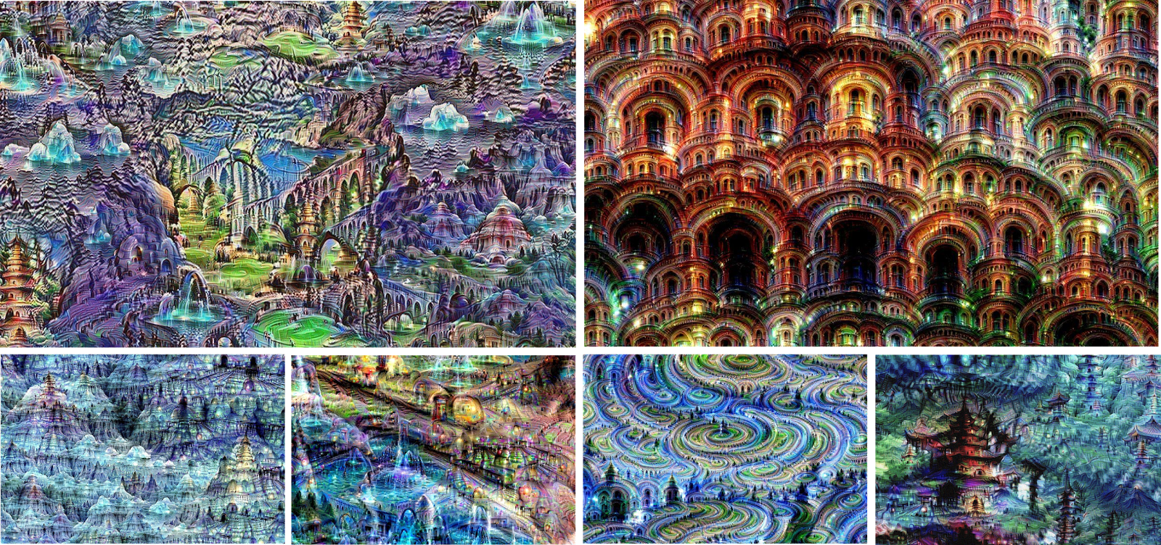
8. Application
□ Google: Neutral Networks and ‘Machine that Dream’
Selection of images created by Google’s neural network
- These days, it’s probably easier to list areas that Google isn’t working on with machine learning.

Slide 55

8. Application
□ Deep Voice Conversion: Neural Voice Cloning

Slide 56
8. Application
□ FarmBeat

Slide 57
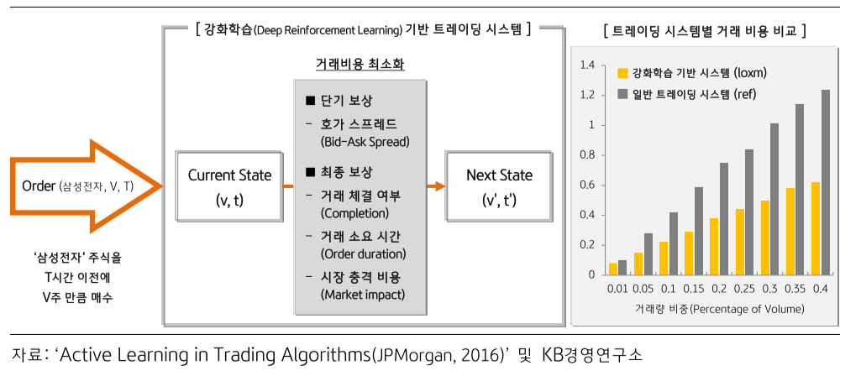
8. Application
□ LOXM: JP Morgan Trading system
- minimize the cost function with the inputs as bid-ask spread, the success of transactions, duration, market impact costs
- great performance compared to the benchmark system

Slide 58
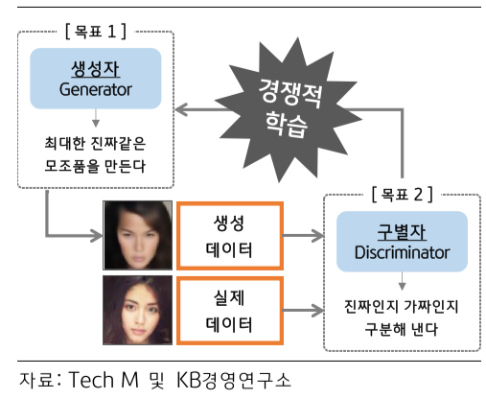
8. Application
□ Fraud Detection
- Making a competition between two model: Generator and Discriminator
- Generator generates fraud-like data
- Discriminator discriminates real one with the generated one
- Good choice when not enough data

Slide 59
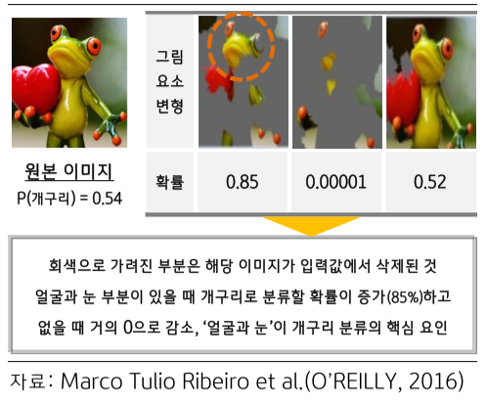
8. Application
□ Credit Rating System
- need to know “why”
- make a small perturbation to the specific variable so that figure out which factor has the most influence for categorization
- FICO: Credit rating company “Reasons Reporter”
- Abnormality detection and Credit Rating

Slide 60
00. Epilogue
THANK YOU
FOR LISTENING

